Slide 1


Sampling bias in the fossil record
Bethany J. Allen | Alex M. Dunhill | Graeme T. Lloyd
Notes:
[Made us all authors in alphabetical order]

Slide 2
Workshop structure
Alex talk (video | slides)
This talk (video | slides)
Scripts (hands on)
Ask questions (best to do other bits first!)
Drop-in Zoom, Friday 12th June 2pm-3:30pm BST, check your emails for the link
Use the ‘#workshop’ channel on Discord
Email the organisers
Notes:
[Maybe colour code these so people can easily visually skip around the video?]

Slide 3
Outline for this talk
Core concepts
Big data
Methods
Notes:
[Maybe colour code these so people can easily visually skip around the video?]

Slide 4
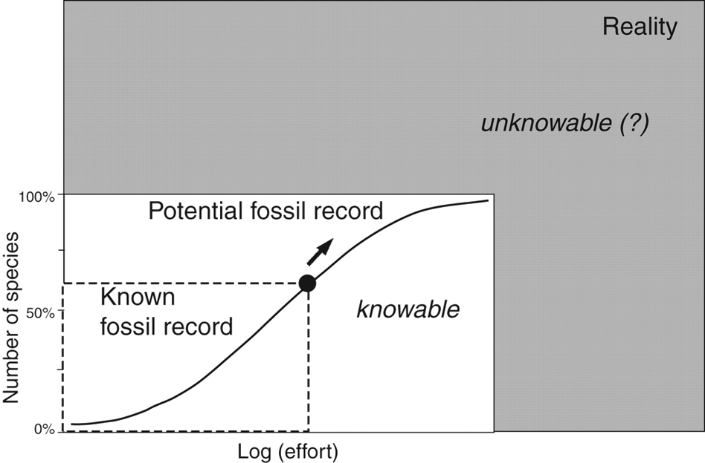
The fossil record is an incomplete record
Benton et al. 2011; In Comparing the Geological and Fossil Records: Implications for Biodiversity
Notes:
Sampling is the relationship between true biological patterns in deep time and our observations of them based on the fossil record

Slide 5
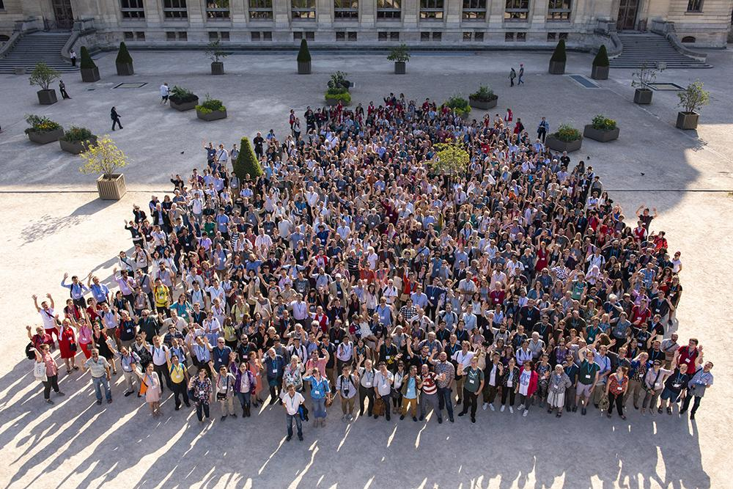


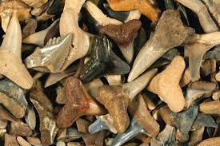

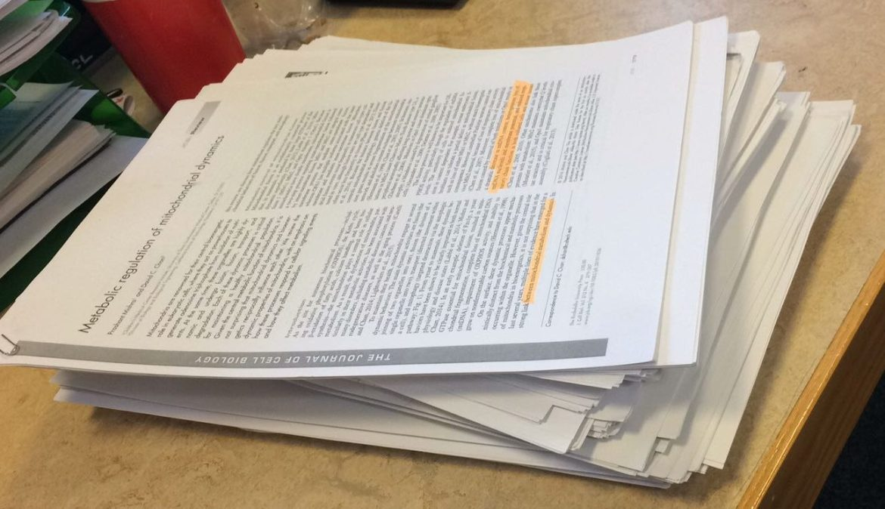
Sampling has many facets
Sampling
Notes:
Many facets, including effort, time, money, N scientists, N papers, N fossils collected

Slide 6
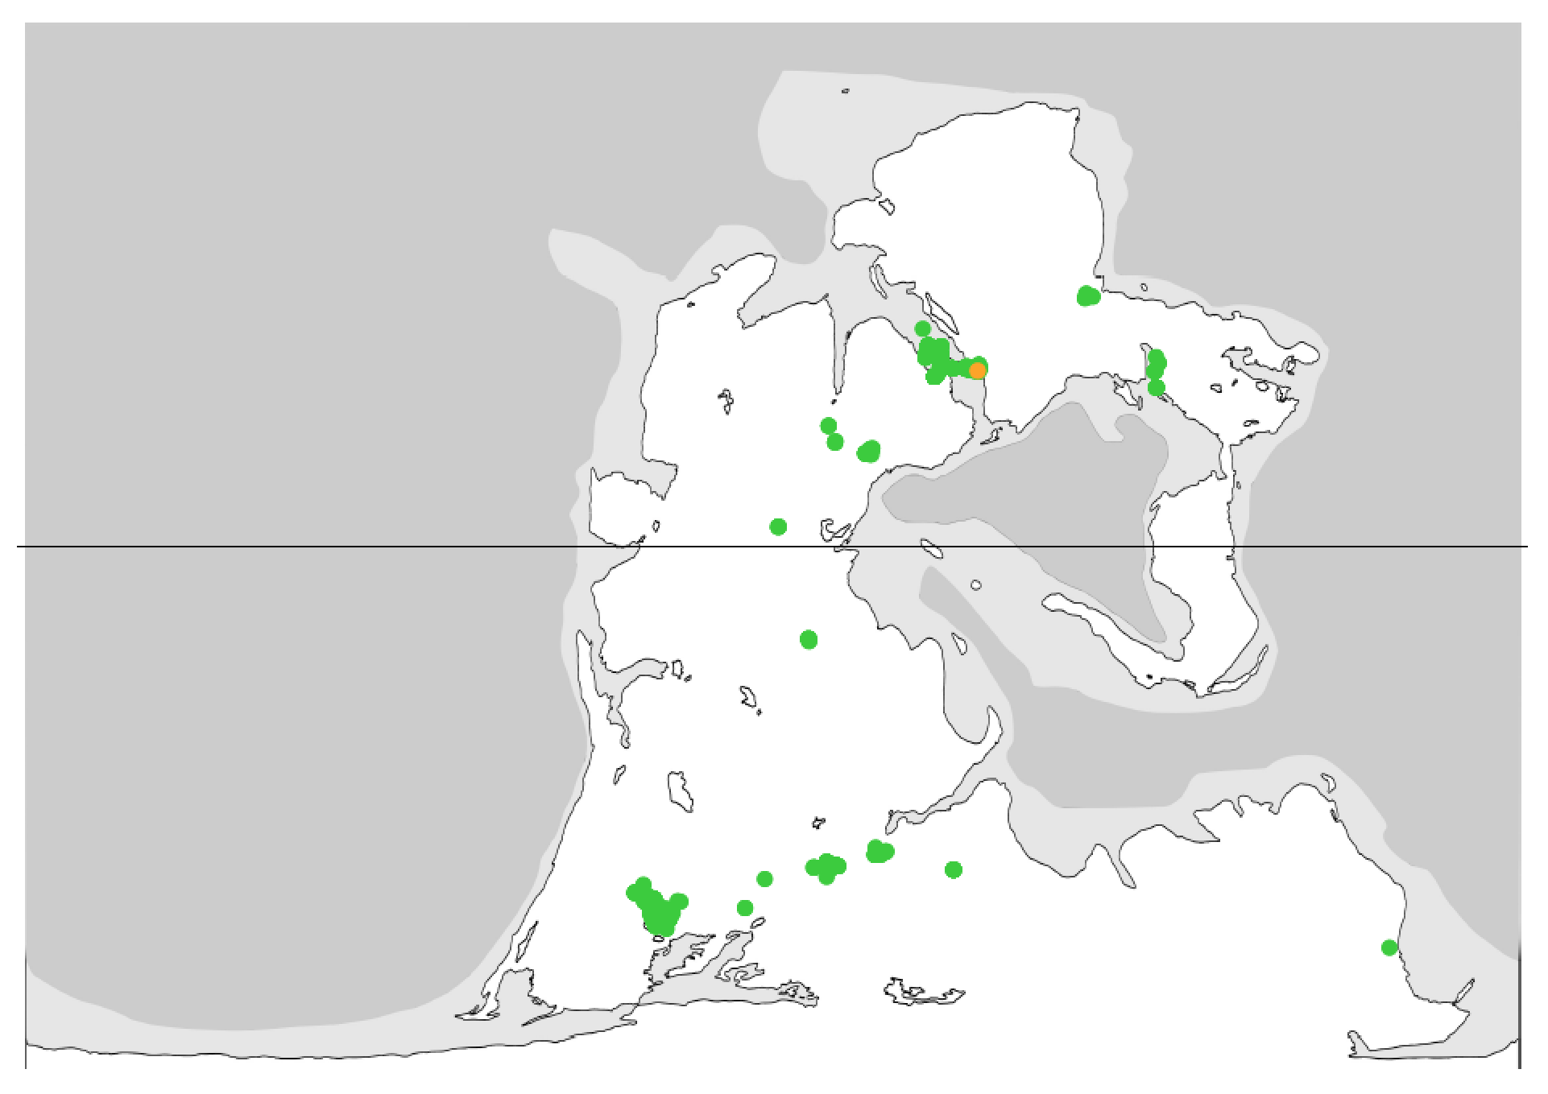
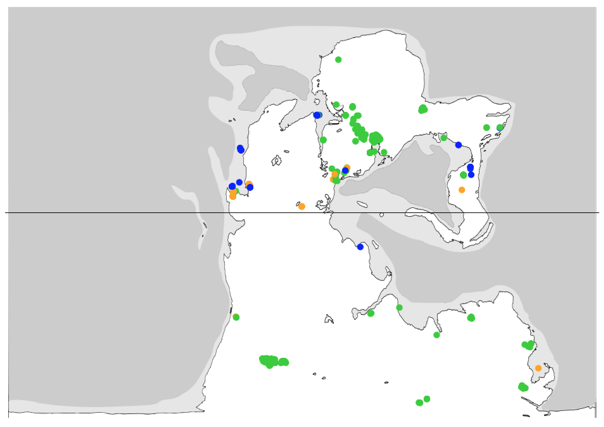
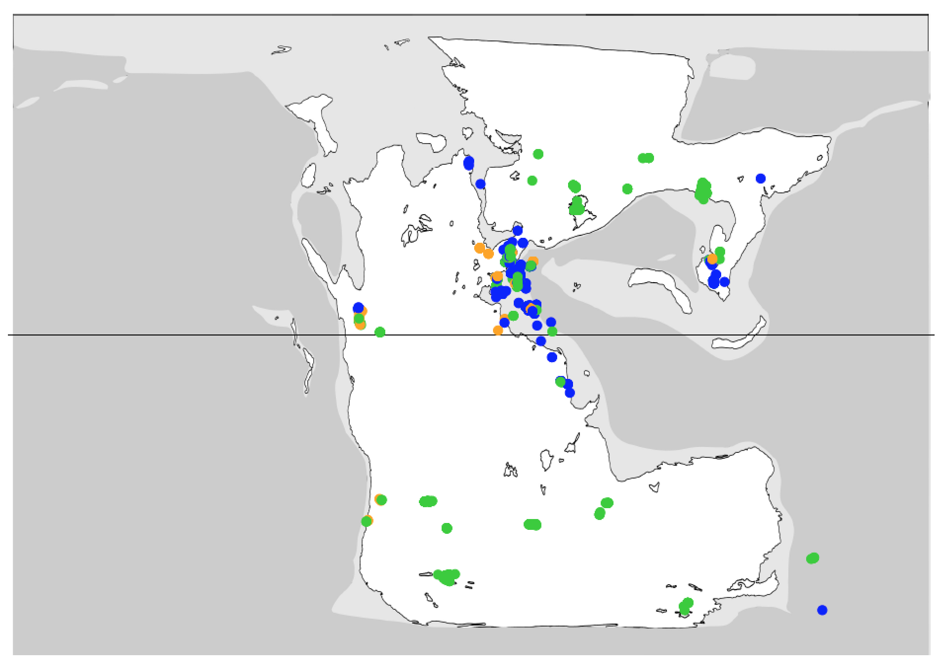
Sampling varies spatially and temporally
Late Permian
Early Triassic
Middle Triassic
Allen et al. in press; Proc. Roy. Soc. B
Notes:
Example from a forthcoming paper on tetrapods

Slide 7
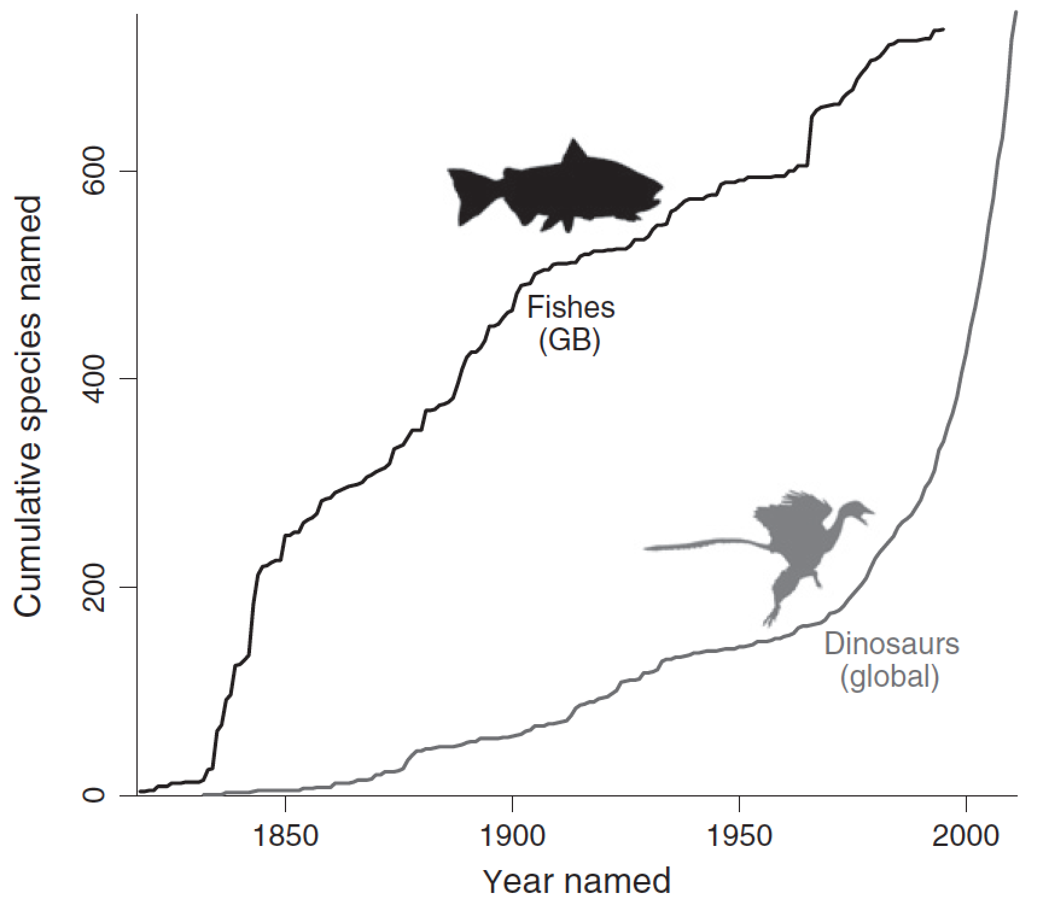
Sampling varies by clade
Lloyd and Friedman 2013; Palaeo3
Notes:
Examples of collector curves (for GB fishes and Mesozoic dinosaurs)
Some groups are still in exponential discovery phase (e.g., dinosaurs)
Others suggest there is little left to find (but the asymptote is not true diversity)

Slide 8
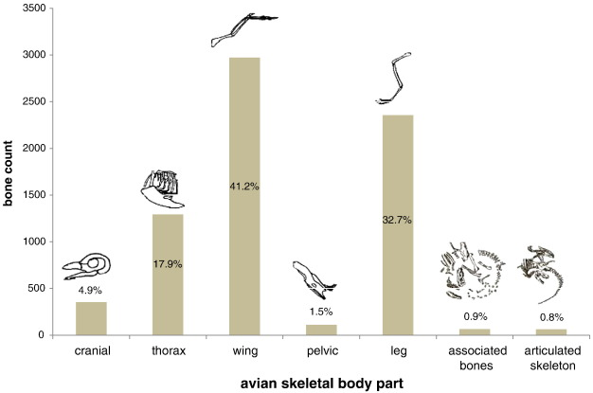
Sampling varies anatomically
Gardner et al. 2016; Palaeo3
Notes:
Variation in sampling affects almost any measure of biotic change through time we might want to measure
For example, different body parts are more or less likely to be preserved or identified, the example here considers bird fossils
Other examples include the contrast in preservation potential between soft and hard bodied animals, which makes reconstructing deep time communities really difficult, and Lagerstatten effects, whereby spikes in estimates of diversity or disparity through time or space might be due to a window of exceptional preservation

Slide 9
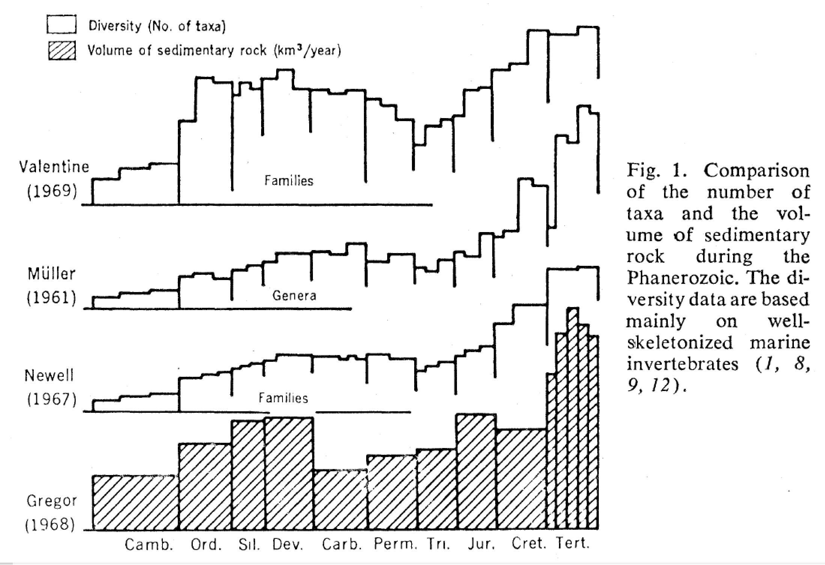
Sampling as explanatory variable: patient zero
88
Raup 1972; Science
Notes:
Patient zero for sampling bias is perhaps Raup’s famous 1972 paper in Science (but even Phillips in 1860 had a partial correction)
Here we see (some old) diversity compilations plotted without shading…
...and below them a very similar shaped curve of amount of sedimentary rock

Slide 10
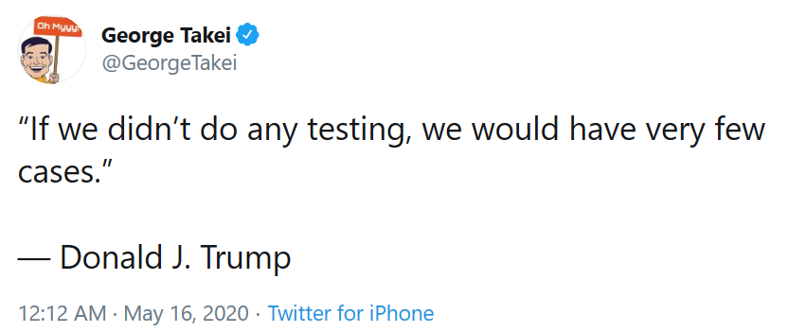
Sampling can drive pattern
Notes:
The key to understanding sampling bias is seeing the difference between evidence of absence and absence of evidence
Is your taxon of interest not found in a place / time bin because it wasn’t there, because it wasn’t preserved, or both?
There are methods for trying to capture this, such as using gap-filler metrics and identifying places where you might expect your taxon to be present but it isn’t

Slide 11
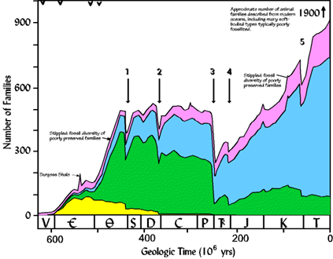
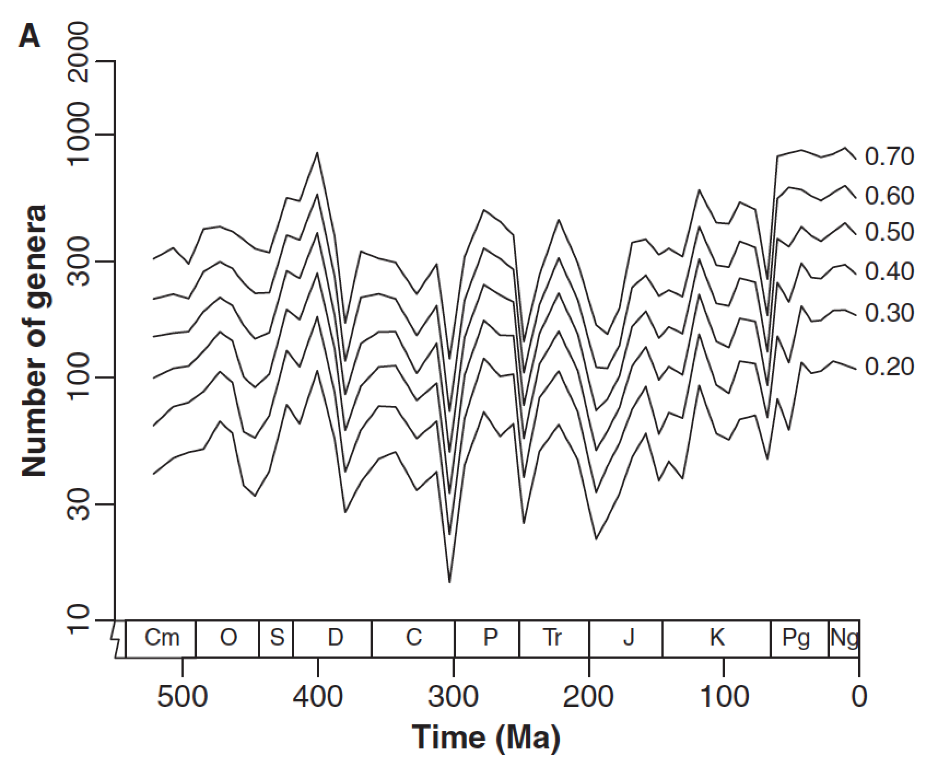
Removing sampling bias
Sepkoski 1984, Alroy 2010; Palaeontology
Notes:
Attempts to remove sampling signal can fundamentally alter our perceptions of biologic history
E.g., Sepkoski’s “Palaeozoic plateau” and modern peak are revised by Alroy’s SQS curve of 2010

Slide 12
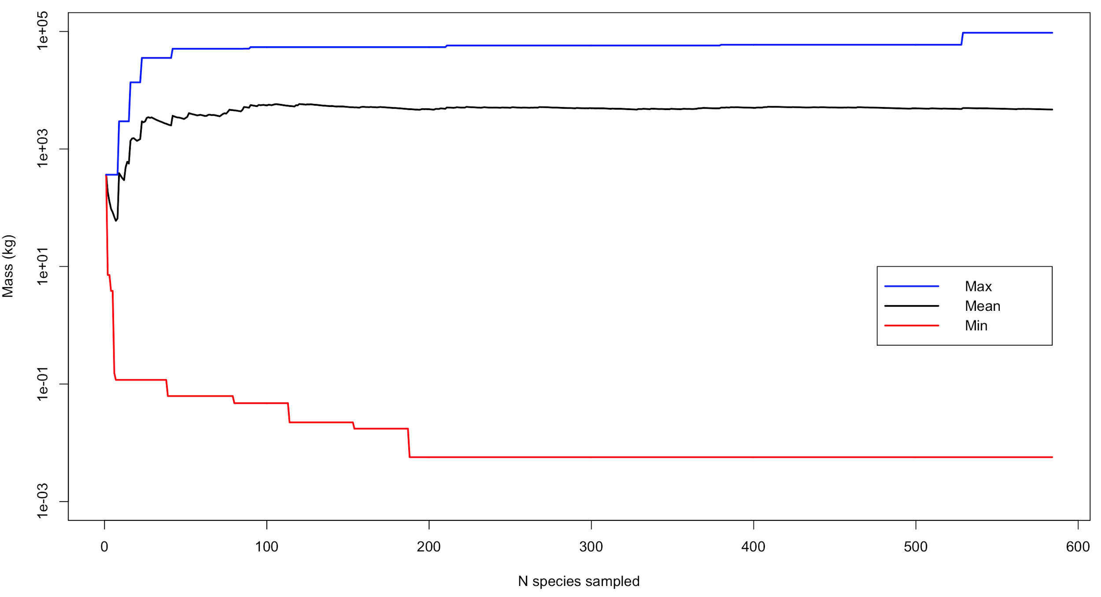
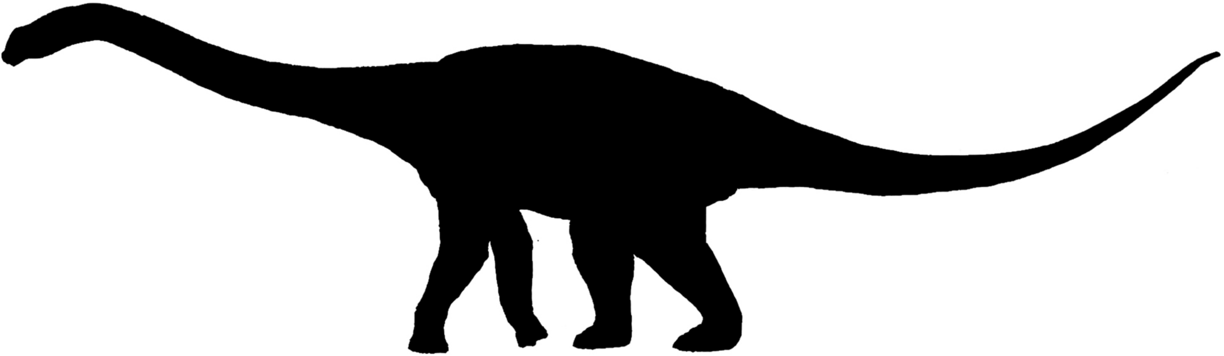
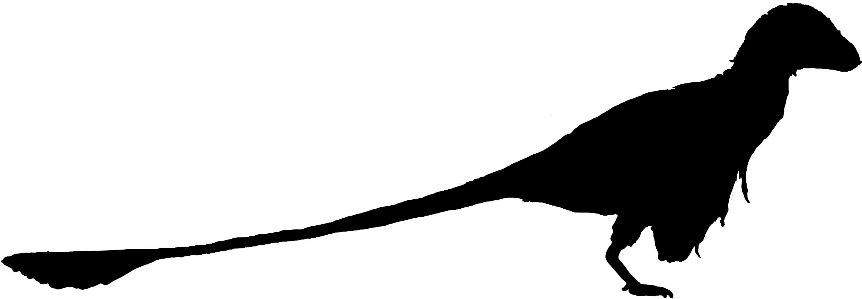
The monotony of it all
Max
Mean
Body mass (kg)
Min
N species sampled
Data from: Benson et al. 2018; Palaeontology
Notes:
Sampling and measurements can co-vary
Usually we are concerned about monotonic relationships, e.g.:
More fossils = more species
More fossils = larger largest fossil/smaller smallest fossil
Without considering sampling may reach wrong conclusion, e.g.:
“Time bin A has more species diversity than time bin B”
“Group X were larger organisms than group Y”

Slide 13
The monotony of it all [code]
# Code to produce plot on previous plot
# Grab the Benson dinosaur body mass data from GitHub:
DinoBodyMasses <- read.table("https://raw.githubusercontent.com/bethany-j-allen/sampling_bias_workshop/master/Data/DinoBodyMasses.txt?token=ABZPFHSQJZOGHAKWFKTP73K6ZUEPA", header = TRUE)
# Shuffle the order to randomly resample the data:
x <- sample(DinoBodyMasses[, "Mass_kg"])
# Set random seed (so you will get exactly same plot):
set.seed(9)
# Resample data as minimum, mean and maximum:
Samples <- do.call(rbind, lapply(as.list(1:length(x)), function(y) {z <- x[1:y]; c(min(z), mean(z), max(z))}))
# Add column names to output:
colnames(Samples) <- c("MinMass", "MeanMass", "MaxMass")
# Make plot:
plot(x = 1:length(x), y = Samples[, "MeanMass"], log = "y", xlab = "N species sampled", ylab = "Mass (kg)", type = "l", ylim = c(0.001, 100000), lwd = 2)
points(x = 1:length(x), y = Samples[, "MinMass"], type = "l", col = "red", lwd = 2)
points(x = 1:length(x), y = Samples[, "MaxMass"], type = "l", col = "blue", lwd = 2)
legend(list(x = length(x), y = 10), legend = c("Max", "Mean", "Min"), col = c("blue", "black", "red"), lty = 1, lwd = 2, merge = TRUE, xjust = 1)

Slide 14
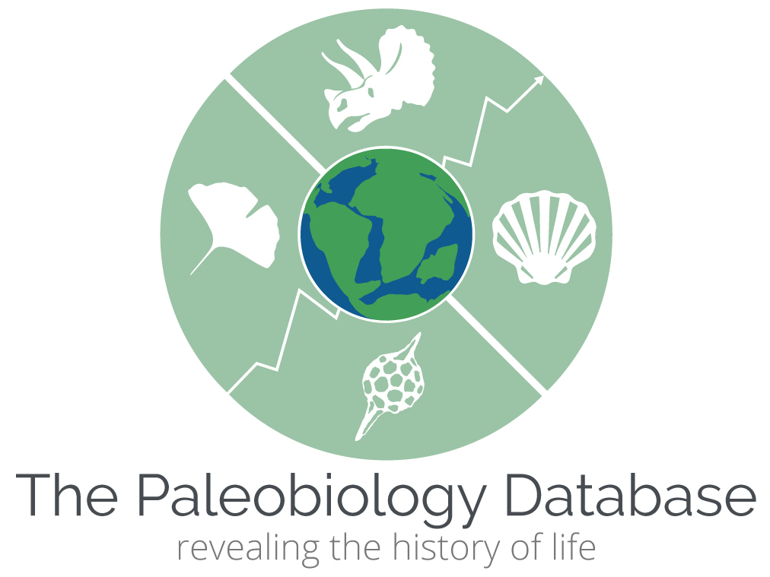
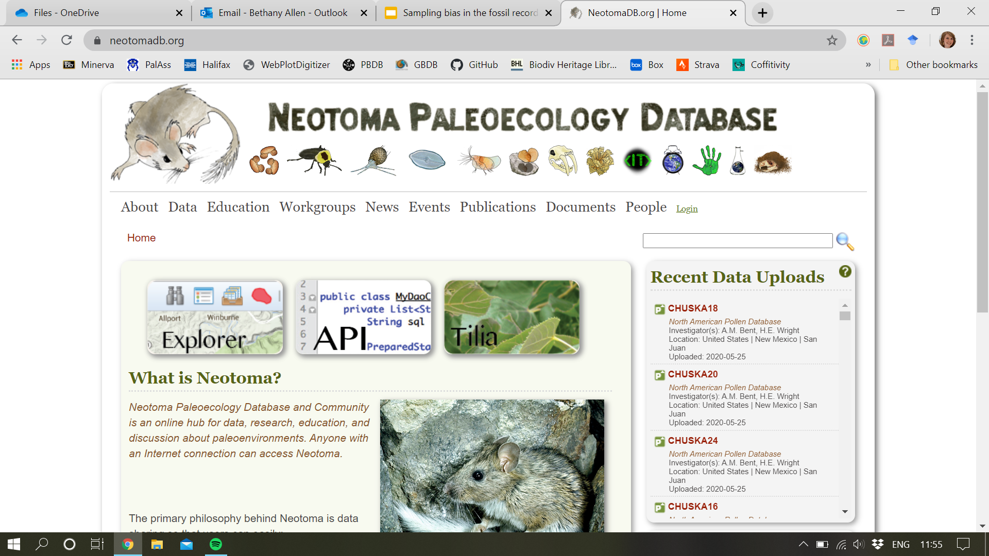




Big data
Notes:
Here are some examples of large-scale databases of palaeontological and ecological data
Sampling bias is scale-based - the larger the scale of your analyses, the more inconsistency between your data points you are likely to be incorporating
Big questions are interesting (global, long time periods, general evolutionary processes) but such datasets are subject to the most sampling bias

Slide 15
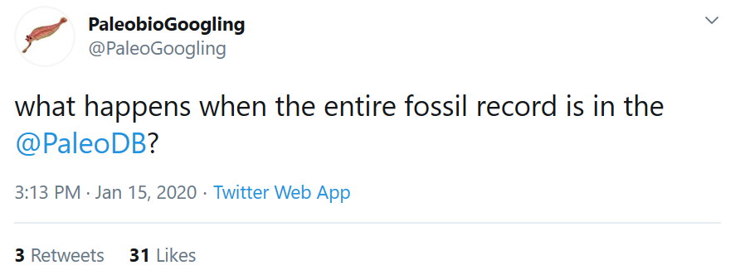
Big data
Notes:
Understanding your dataset is key to seeing its underlying flaws
Especially for collaborative big data, contributing to data collection and entry can really help you to see the decisions behind the data

Slide 16
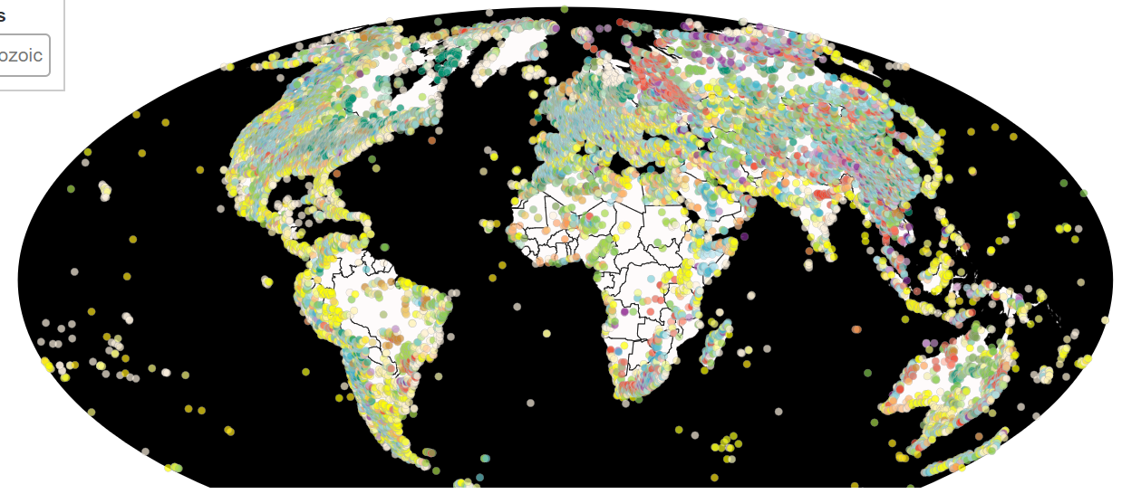
Paleobiology Database
paleobiodb.org
Notes:
The Paleobiology Database is one of the most popular sources of big datasets in palaeo
This is all of the Phanerozoic occurrences in the PBDB. Some things are quickly evident: the volume of data is huge, sampling through space is variable, sampling through time is also variable (indicated by the colour of the dots).

Slide 17
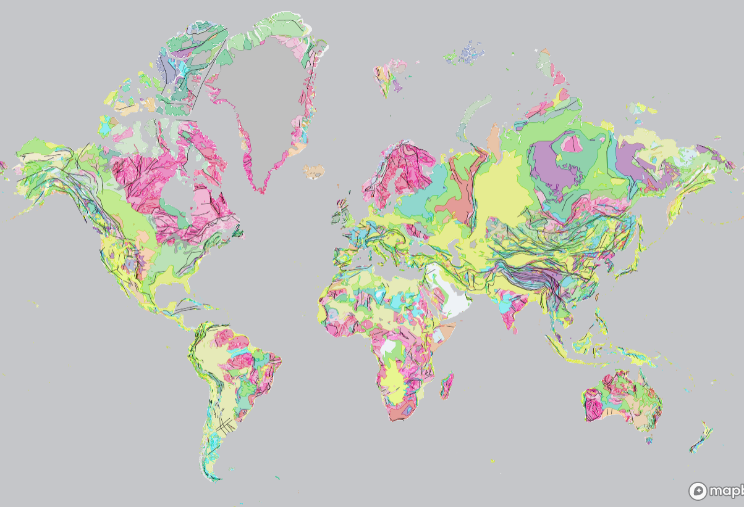
Macrostrat
macrostrat.org
Notes:
Macrostrat is an open access geological map platform, collaborating with geological surveys around the world
The resolution of the data is highly variable with geography - some countries are more thoroughly mapped than others, and some countries are more open about this information than others!
It’s a great resource for understanding the difference in rock area available through time, an important control on fossil collection

Slide 18
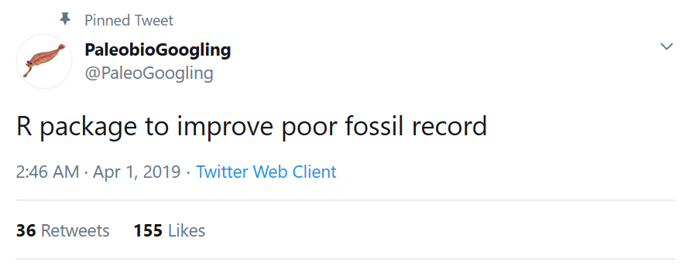
Help! My data are biased
Notes:
It’s okay - the first step is realising this, you’ve already managed that!
Unfortunately there’s no blanket fix or correction (although sampling proxies were considered to be for a little while, that’s not true)
The appropriate action to take is highly dependent on your question(s), and often the first step is to read around the methods, what have other people tried and what are the issues with their approaches?

Slide 19
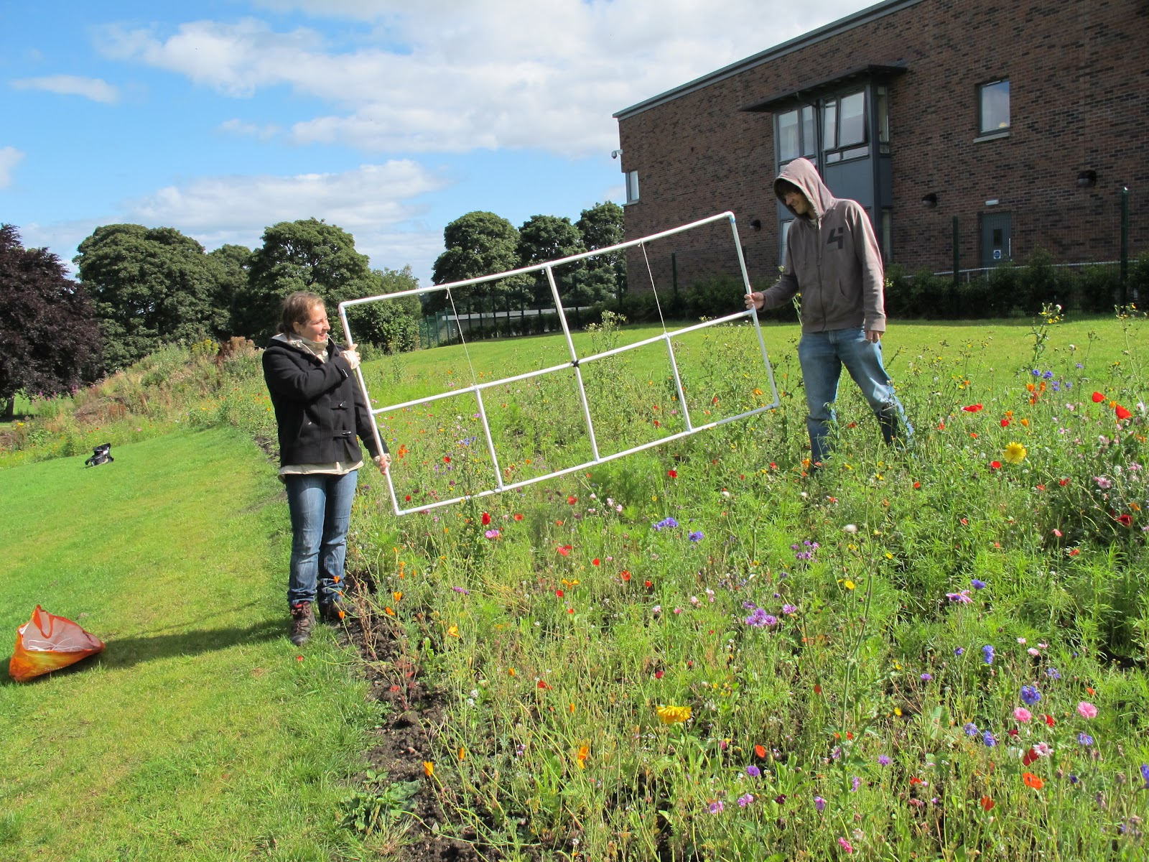
Methods
Notes:
Most methods used by palaeontolgists are taken from the ecological literature
Here it is assumed you are doing something like dropping a quadrat in a meadow and counting everything you find inside of it - obviously the fossil record is very different!
Having said that, sampling bias is just as important in data collection for extant species, but from different sources and to different scales

Slide 20
Keeping it simple?
No. of fossils
Triassic
Jurassic
Cretaceous
Notes:
It’s a common problem in palaeontological data analysis to want to compare two or more samples, which are usually of different sizes
We want to make comparisons between these samples using the ‘fairest’ approach, by statistically manipulating these datasets to make them as comparable as possible
The first attempts to do this considered that equal sampling between bins was ‘fairest’, how does this work?

Slide 21
Extrapolation
No. of fossils
Triassic
Jurassic
Cretaceous
Notes:
Extrapolation uses a random sampling process to increase the number of observations for a smaller sample...

Slide 22
Subsampling: rarefaction and bootstrapping
No. of fossils
Triassic
Jurassic
Cretaceous
Notes:
… while subsampling or rarefaction uses a random sampling process to reduce the number of observations in a larger sample.
Both of these processes are usually done iteratively, for example 100 times, with results averaged across these 100 iterations. This is a process called bootstrapping, and is a relatively simple way to artificially create equal sample sizes between the things you want to compare.
At first thought, equal sampling between bins seems reasonable - however, the size of those samples is probably controlled by both underlying differences in biological abundance and sampling bias, so equal sampling throws out all of this information

Slide 23
Collector’s / Species Accumulation Curves
Richness
Sampling
Notes:
More popular methods now are based on coverage, an estimate of how ‘complete’ sampling is for that sample
The ideas surrounding this are based on the collector’s curve model, or species accumulation curves (as they are known in modern ecology)
Imagine you are going for a field season fossil hunting in a newly discovered locality...

Slide 24
Collector’s / Species Accumulation Curves
Richness
Sampling
Notes:
… the first few fossils you find are going to be the first of their species known from that locality, so the increase in diversity known in that locality will be rapid.

Slide 25
Collector’s / Species Accumulation Curves
Richness
Sampling
Notes:
When you go back for your second field season, some of the new fossils you find will be new species from that locality, whereas others will be of the same species you saw on your first field season, so the additional diversity discovered will be slightly reduced compared to your first visit.

Slide 26
Collector’s / Species Accumulation Curves
‘True’ diversity
Richness
Sampling
Notes:
When you go back for your third season, you might find one or two new species, however the majority of fossils you find will be from species you have previously identified at the locality. This means that the collector’s curve is levelling, and suggests that the diversity known at the locality is asymptoting at (or near to) the ‘true’ diversity level.
Remember that this ‘true’ diversity only reflects the ‘potential fossil record’ from Slide 3, and not necessarily biological reality!
Coverage-based methods therefore use the relationship between abundance and diversity in a sample to estimate how far along the curve a sample is, or how well ‘covered’ it is in relation to the ‘true’ or asymptotic diversity level.

Slide 27
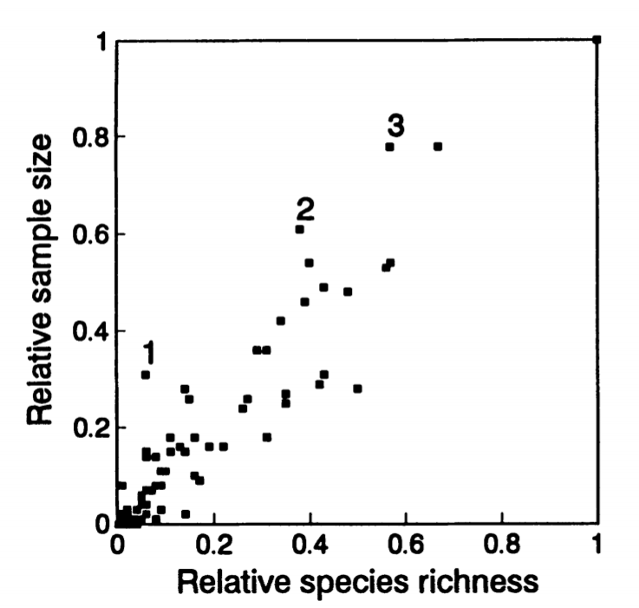
Bootstrapping example
The relationship between sampling and richness in combinations of trilobite subgroups and stratigraphic intervals (Fig. 1)
Foote 1993; Paleobiology
Notes:
Mike Foote was the first to suggest using bootstrapping to try and understand evolutionary patterns using fossils
Each point on the left is a combination of trilobite subgroup and stratigraphic interval, indicating a strong relationship between sample size and diversity (r2 = 0.90)

Slide 28
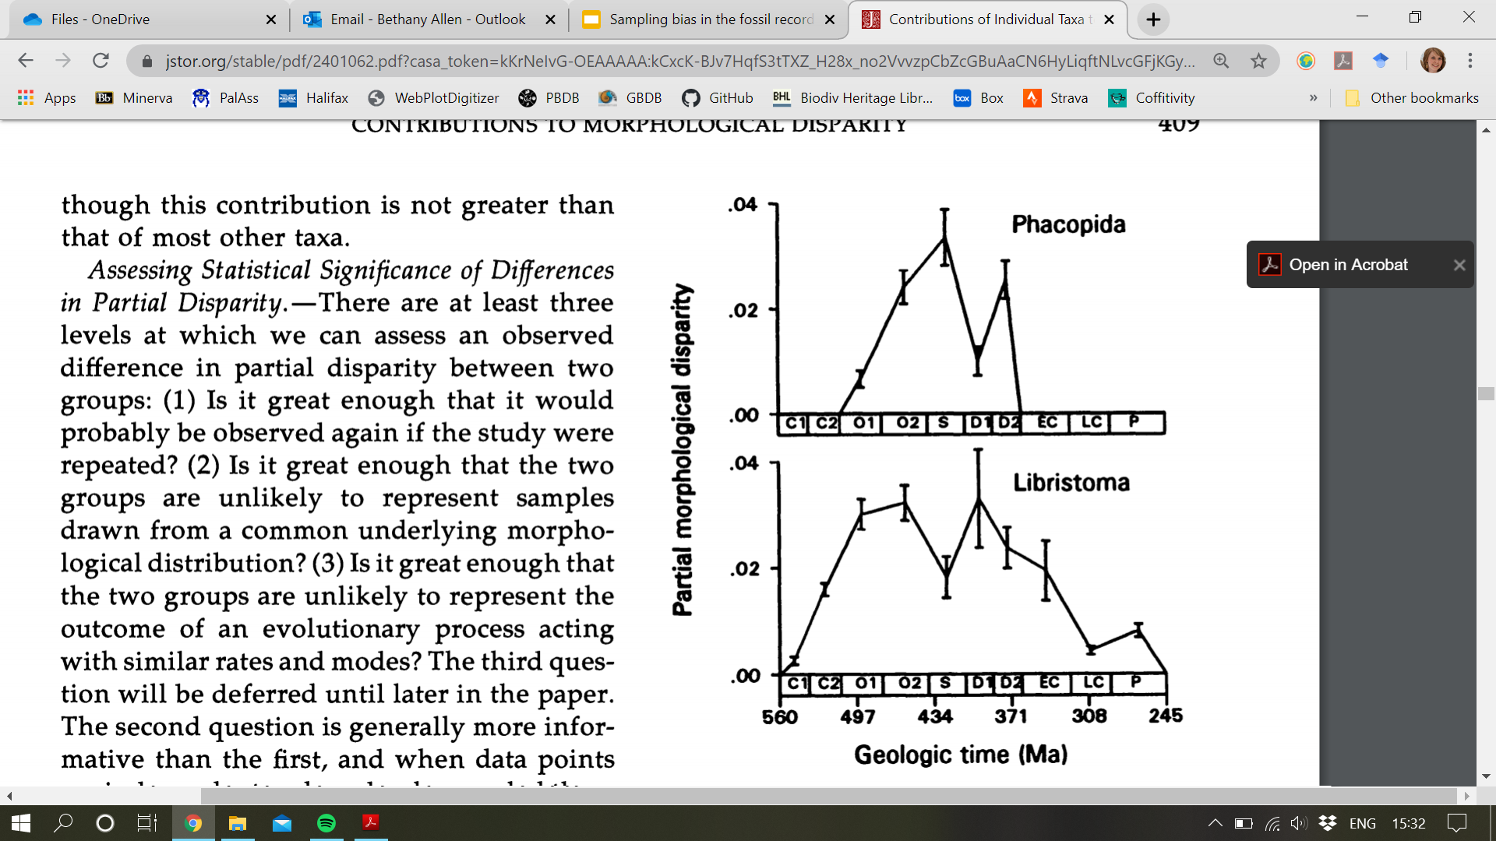
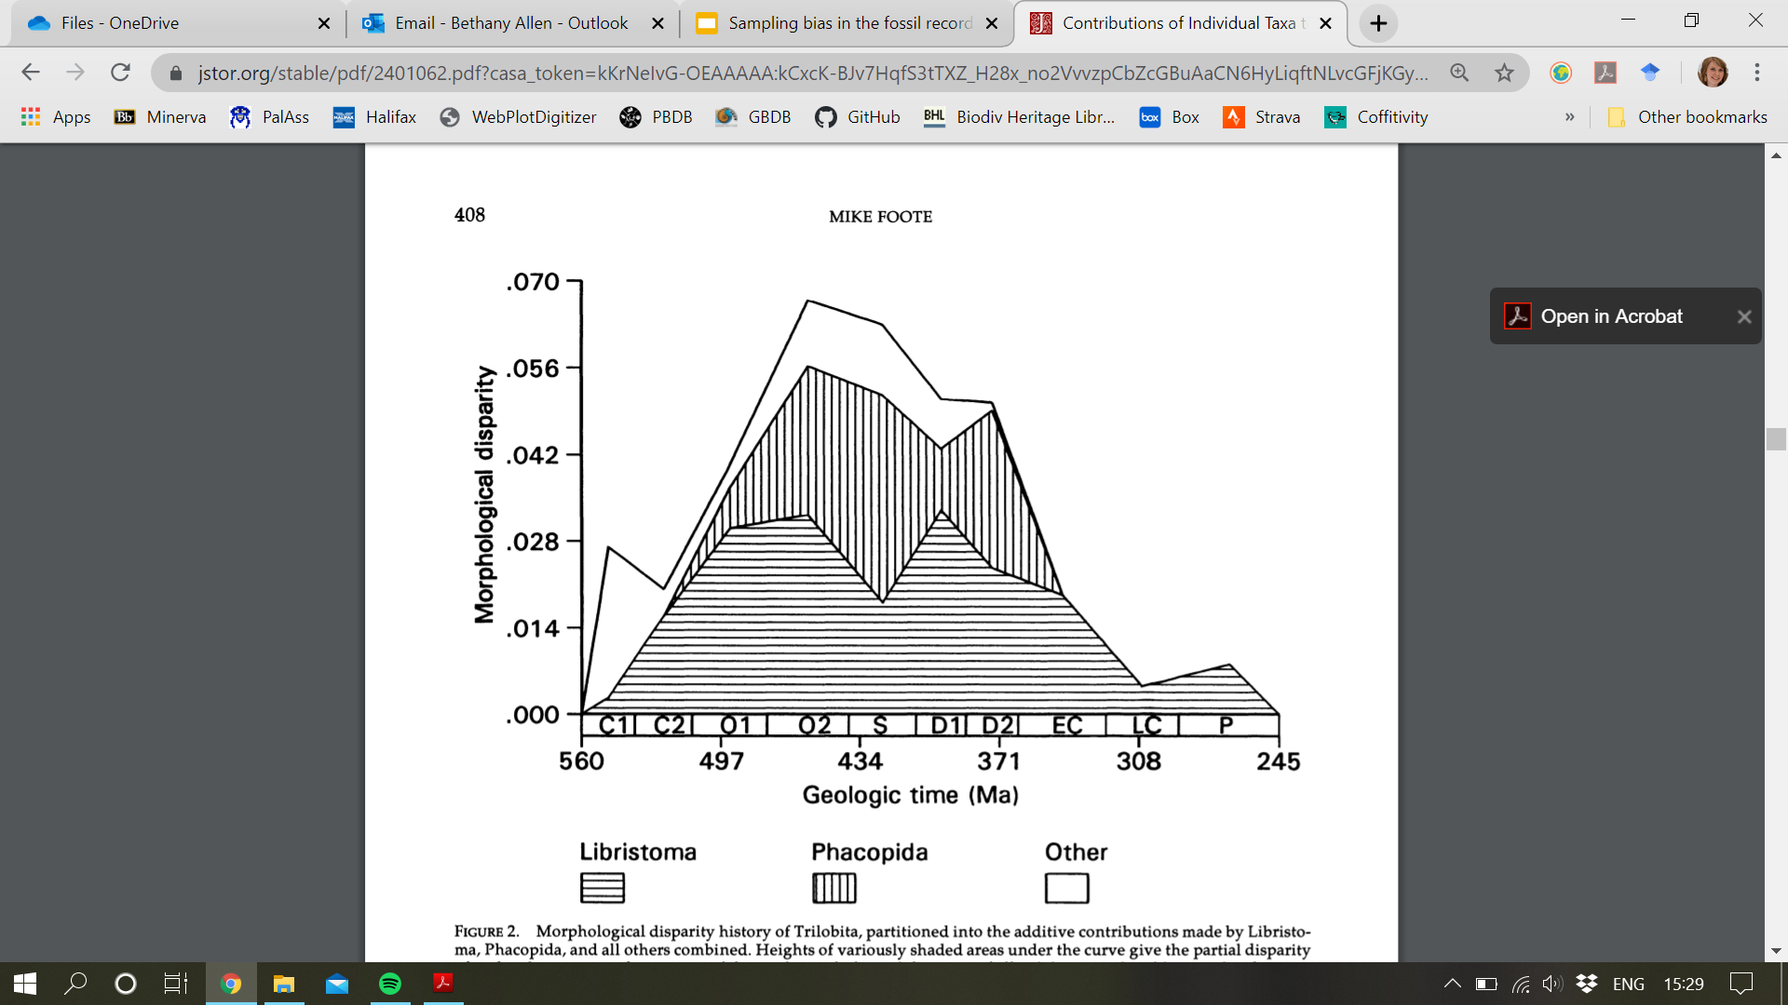
Bootstrapping example
The contribution of different trilobite groups to overall morphological diversity through time (Fig. 2)
The contributions of Phacopida and Libristoma to overall trilobite disparity, taking into account sampling through a bootstrap regime (Fig. 3)
Foote 1993; Paleobiology
Notes:
He examined the change in overall morphological disparity of trilobites through time, and the relative role of different taxonomic subgroups in contributing to this diversity
He also used bootstrapping to see whether changes in the known numbers of these trilobites through time was affecting their contribution to this morphological disparity

Slide 29
Subsampling and “The Ghostbuster’s Problem”
A
A > B
A = B
B
A < B
Richness
Sampling
Notes:
This is really important to understand when comparing two datasets - looking at the raw occurrences, one might contain more species than the other, but it could just be that the richer dataset has a higher ‘sampling completeness’ than the other
Coverage-based methods therefore attempt to scale curves for each sample on these two axes, so that you can compare diversity levels between them at a sampling completeness of your choice

Slide 30
Rank order abundance
Most common species
Abundance
Least common (rarest) species
Abundance rank
Notes:
Important concept in ecology is rank order abundance - can be exploited for subsampling
Once rarest species is sampled at least twice can expect that all species are sampled (or at least all sampleable species if considering fossils)
Shape of distribution effects evenness and any subsampled diversity estimate

Slide 31
Coverage-based methods
Proportion of area (quotient)
Abundance
Subsampled diversity estimate
Abundance rank
Notes:
Can also consider rank order abundance as a “curve” and ask for areas underneath it (“quotients”)

Slide 32
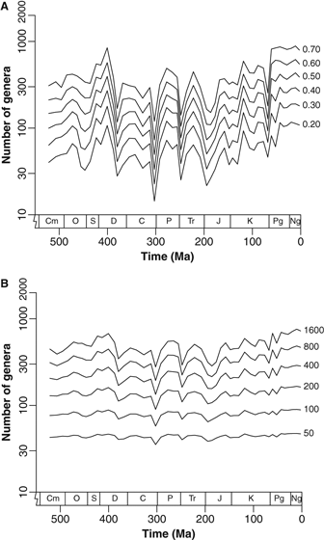
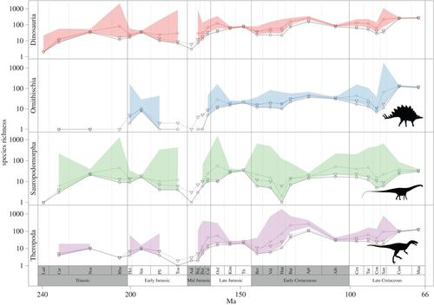
Coverage-based methods
Alroy 2010; Palaeontology
Shareholder Quorum Subsampling (SQS)
Starrfelt & Liow 2016; Proc. Roy. Soc. B
True Richness estimated using a Poisson Sampling model (TriPS)
Notes:
SQS, TRiPS, Chao1 and Squares are all examples of coverage-based methods, see Further Reading; examples here of both extrapolation (e.g. Squares) and subsampling (e.g. SQS)

Slide 33
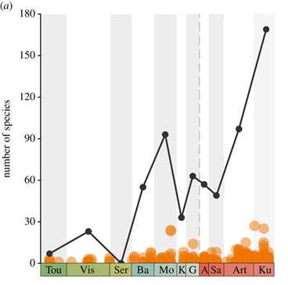
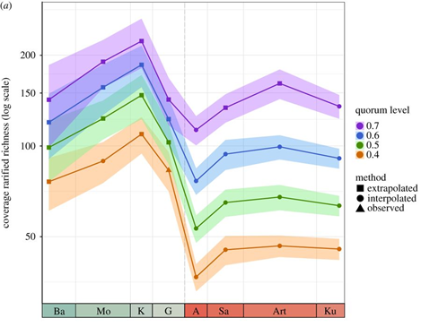
Coverage-based examples
Raw tetrapod diversity curve for the Carboniferous-early Permian (Fig. 1a)
SQS tetrapod diversity curve for the Carboniferous - early Permian (Fig. 3a)
Dunne et al. 2018; Proc. Roy. Soc. B
Notes:
Emma’s paper examined PBDB occurrences of tetrapods through the Carboniferous and early Permian, looking for a drop corresponding with the Carboniferous Rainforest Collapse
The raw data shows a drop in diversity in the Kungurian, however the SQS analyses show that this drop is a sampling artefact, and that actually diversity was likely highest in the Kungurian

Slide 34
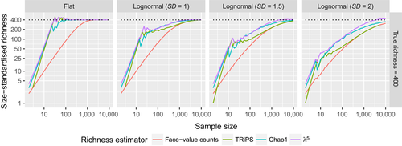
Which is best?
Close et al. 2018; Methods Ecol. Evol., see also: Alroy 2020; Paleobiology
Notes:
Recently some papers have attempted to address comparing popular methods, using simulations to quantify ways in which some are objectively better than others - Close et al. is a helpful, if a little technical, paper
The major take-home is that sample size (number of fossils) is always going to be the biggest hindrance to quantifying diversity in the fossil record (you can see this on the x-axis of each panel)
The second is that all three of the methods used here perform better than raw counts at small sample sizes (curves are higher / closer to the true value)
The third is that the less taxonomically even your sample is (common and rare taxa rather than an even distribution), the less likely your richness estimate is to reflect the true diversity

Slide 35
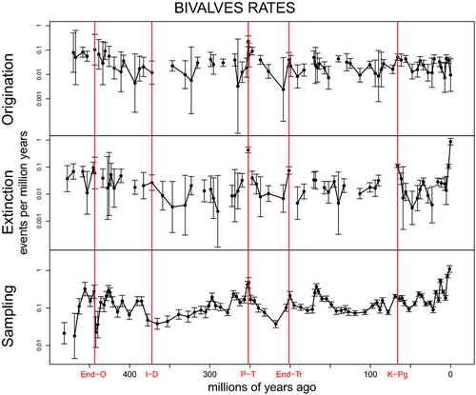
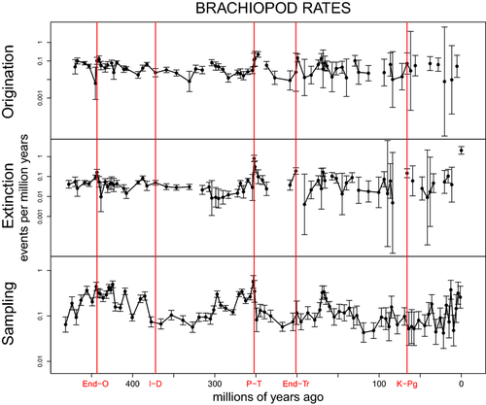
Capture-mark-recapture
Liow et al. 2015; Ecol. Lett.
Notes:
CMR is a statistical approach which aims to emulate the classical ecological sampling technique
The aim is to estimate sampling completeness while also calculating other evolutionary parameters such as origination and extinction rates, or diversity

Slide 36
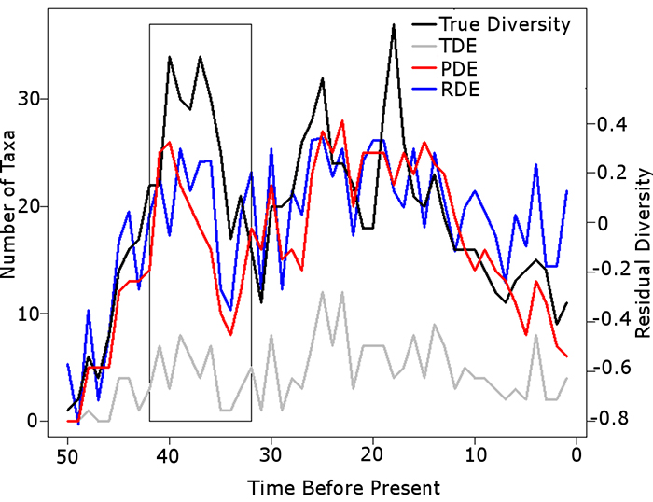
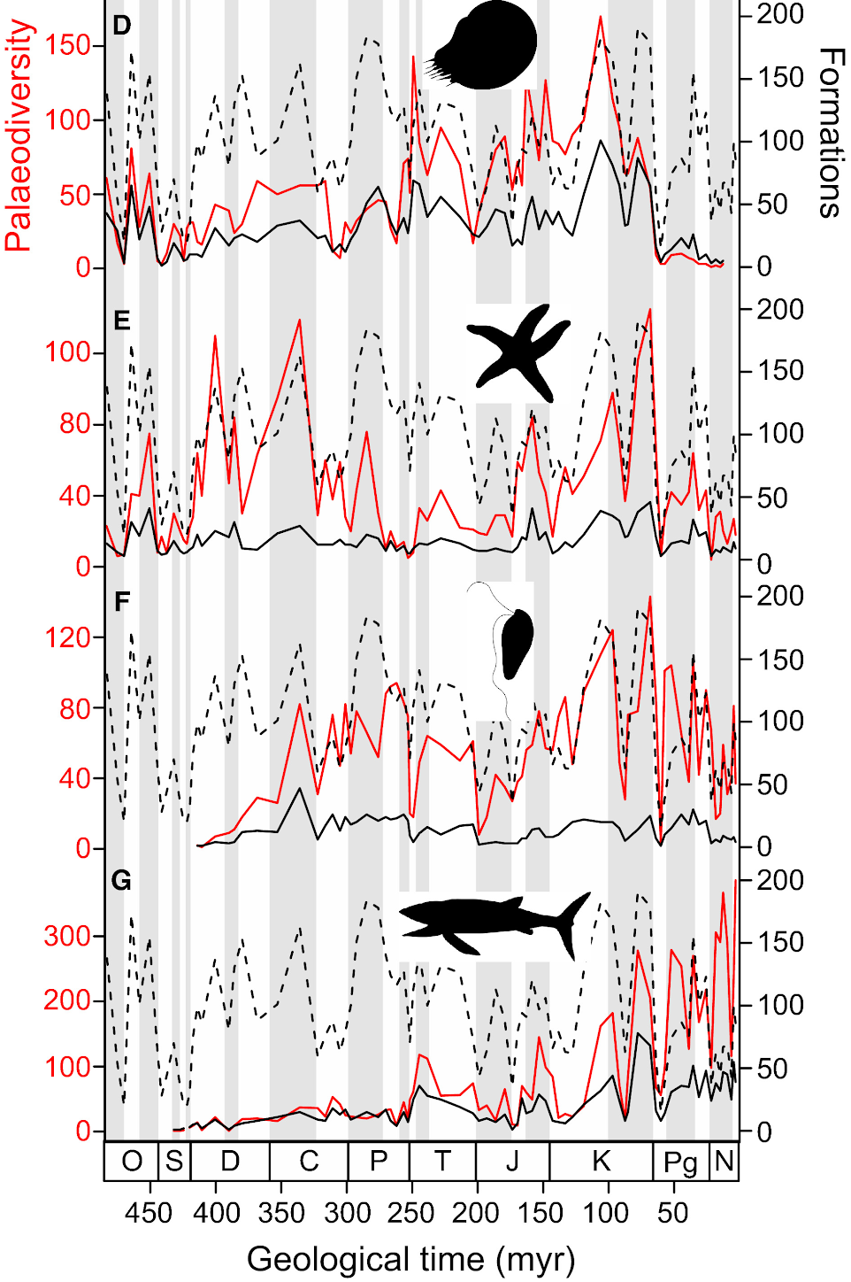
Sampling proxy correction
Brocklehurst 2015; Palaeo. Electronica, Dunhill et al. 2018; Palaeontology
Notes:
Some papers have previously tried to use sampling proxies such as formation counts as a ‘correction’ for sampling bias, also known as a residual modelling approach
Evaluation of these methods using a simulation approach have shown that such sampling proxies and raw fossil diversity are too closely interlinked; ‘correction’ loses the true signal as well as the effect of sampling

Slide 37
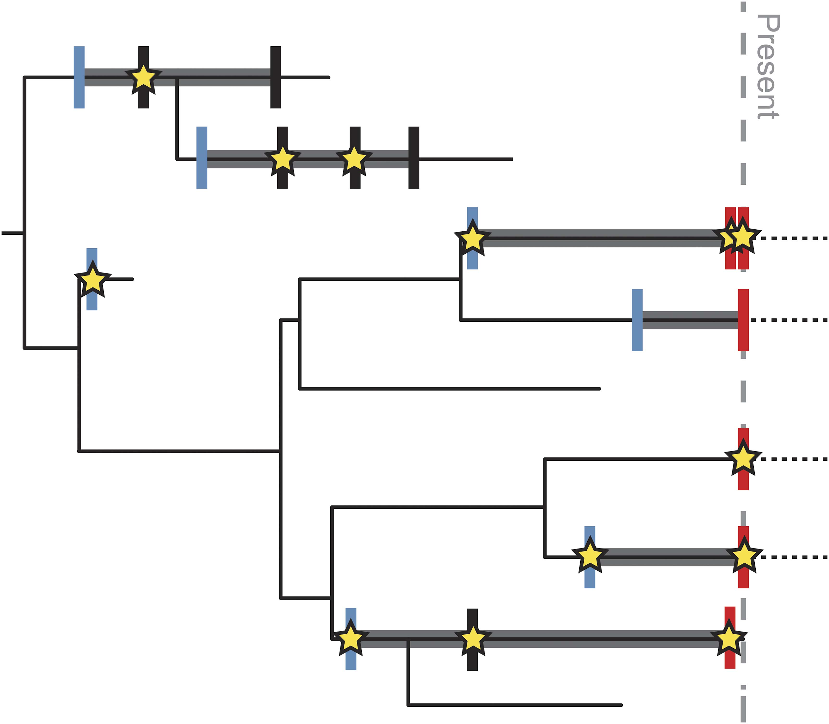
Who needs fossils when you have trees?
Hopkins et al. 2018; Paleobiology
Notes:
There are also methods being developed which use evolutionary models to build phylogenetic trees, such as the fossilised birth-death model
Fossil data can be incorporated into the model, which in turn can give insights into sampling completeness, estimates of total clade diversity, and speciation and extinction rates

Slide 38
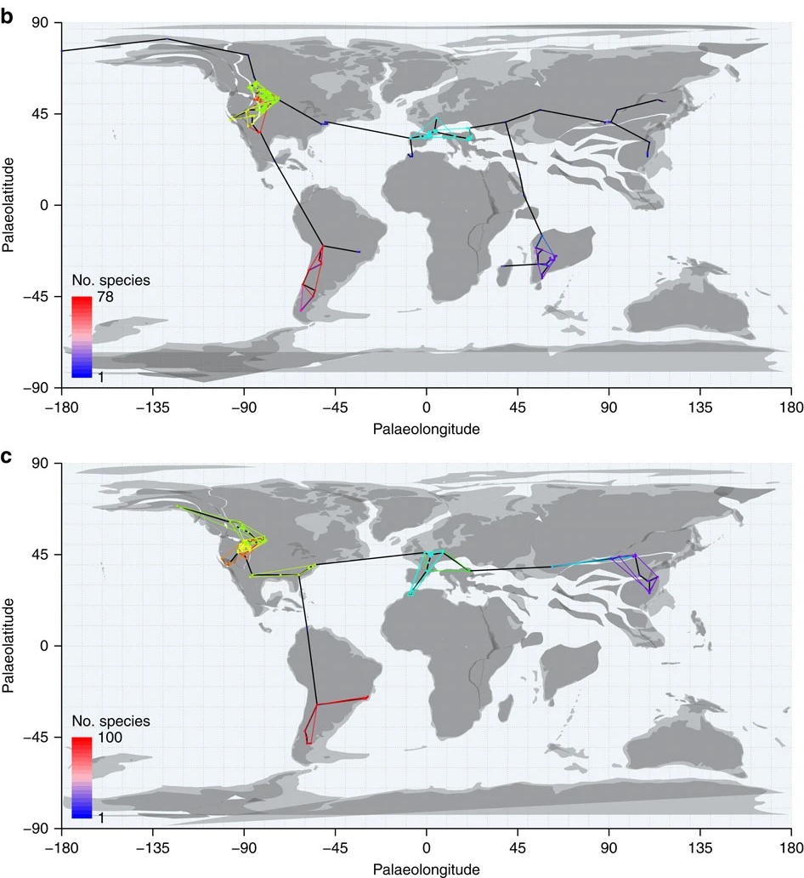
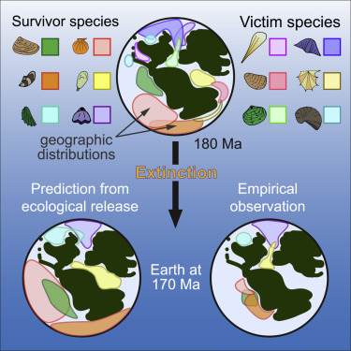
Space vs time
Close et al. 2017; Nature Comms.
Antell et al. 2020; Curr. Biol.
Notes:
Most previously mentioned methods are implemented across time, i.e. comparing stages - recently methods have also been developed to control for sampling variation across space, particularly necessary when interested in global patterns
These methods generally assume fossil absence results from no sampling, and designate well-sampled regions to compare between
Some of these methods are quite complex, but it’s a rapidly moving area of sampling bias research, so may become easier to implement in the near future

